Slide 1
Searching and Sorting Techniques
[Module – 6]
WCE - SY (CSE) – 1CI 202: Data Structures
Course Teacher: Dr. Smriti H. Bhandari

Slide 2
What to Study?
Searching
Importance of searching
Search Algorithms
Sequential, Binary, Fibonacci
Sorting
Quick sort
Two-way merge sort
Heap sort
Shell sort
Radix sort
2

Slide 3
Complexity of Algorithms
Suppose M is an algorithm and n is the size of the input data.
Two main measures for efficiency of M:
Time
Measured by counting the number of key operations (e.g. comparisons in searching/sorting)
Space
Measured by counting the maximum of memory needed by the algorithm
3
Notes:
Analysis of algorithms is a major task in computer science.
In order to compare algorithms, we must have some criteria to measure the efficiency of our algorithms.

Slide 4
Complexity of Algorithms
Worst case Complexity
The maximum value of f(n) for any possible input
Average case Complexity
The expected value of f(n)
Best case Complexity
The minimum possible value of f(n)
4
Notes:
Analysis of algorithms is a major task in computer science.
In order to compare algorithms, we must have some criteria to measure the efficiency of our algorithms.

Slide 5
Big O Notation
Suppose M is an algorithm and n is the size of input data.
Complexity f(n) of M increases with n.
Important to examine rate of increase of f(n) and done by comparing f(n) with some standard function g(n) such as log₂n, n, n log₂n, n², n³, 2n etc. ➔ use functional O notation ➔ f(n) = O(g(n)) ➔ “f(n) is of order g(n)”

Slide 6
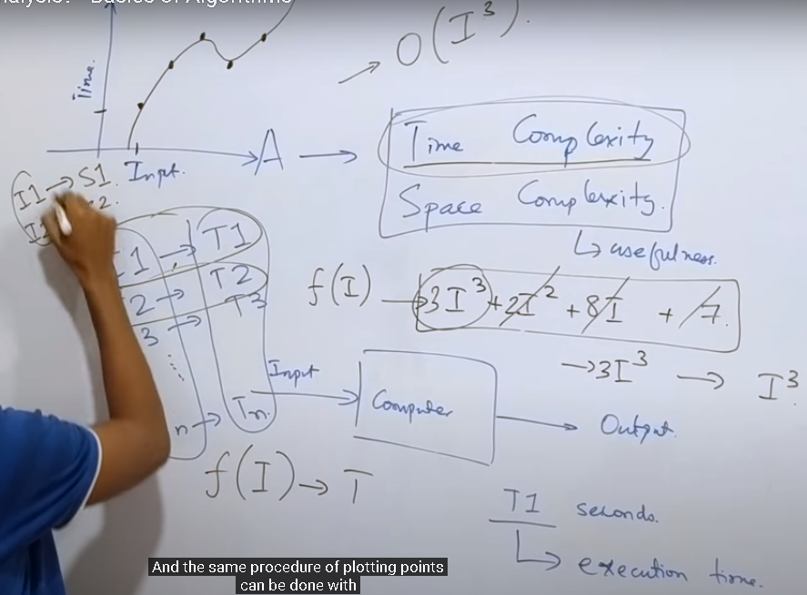
Space and time complexity
6

Slide 7
Searching
7
Sequential Search
Binary Search
Fibonacci Search

Slide 8
Sequential / Linear Search
Searching in a linear list
Element by element comparison with the search key
Used whenever the list is not ordered.
Typically used for small lists or lists that are not searched often.
8

Slide 9
Sequential / Linear Search
Analysis
Best Case
First element itself is the required element
Only one comparison is needed
Best case time complexity is 1
Worst case
None of the element is same as the search element
If the list consists of n elements, then n comparisons are needed
Worst case time complexity is n
Average number of comparisons = (n+1)/2 i.e. order of complexity is O(n) ➔ as power for n is 1 in complexity expression, it is called as linear search algorithm.
Also known as serial or sequential search or brute force search
9
Notes:
Average case
Here we assume that ITEM does appear in DATA, and that is equally likely to occur at any position in this array. Accordingly, the number of comparisons can be any of the numbers 1,2,3,…,n and each number occurs with probability p=1/n, then
C(n) = 1*1/n + 2* 1/n + … + n*1/n
= (1+2+…+n) * 1/n
=(n(n+1)/2 )* 1/n
=(n+1)/2

Slide 10
Binary Search
10
The sequential search is very slow
If the array is sorted, binary search is more efficient
Notes:
Consider binary searches whenever the list contains more than 16 elements.

Slide 11
Algorithm binarySearch (list, last, target, loc)
//Search an ordered list using binary search
//list is ordered and must contain at least one element
//Last is index to largest element in the list
//target contains data to be searched
//loc is address where the found element’s index location is to be stored
//Return found true or false
set begin to 0
set end to last
loop (begin <= end)
set mid to floor((begin + end) / 2)
if (target > list[mid])
// look in upper half
set begin to (mid+1)
else if (target < list[mid])
// look in lower half
set end to (mid-1)
else
// Found: force exit
set begin to (end+1)
end if
end loop
set loc to mid
if (target equal list[mid])
set found to true
else
set found to false
end if
return found
End binarySearch
11

Slide 12
Binary Search
The loop in algorithm divides the search in two halves ➔ logarithmic loop
Efficiency of binary search is O(log n)
12

Slide 13
Fibonacci Search
When the elements being searched have non-uniform access memory storage (i.e. the time needed to access a storage location varies depending on the location previously accessed), the Fibonacci search has an advantage over binary search

Slide 14
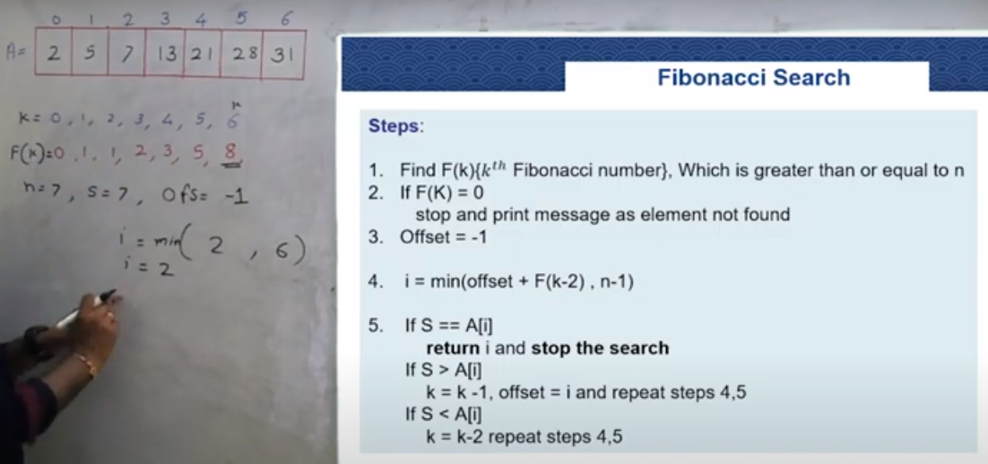
14
Notes:
Fibonacci search has an advantage over binary search in slightly reducing the average time needed to access a storage location.
The typical example of non-uniform access storage is that of a magnetic tape, where the time to access a particular element is proportional to its distance from the element currently under the tape's head. Note, however, that large arrays not fitting in cache or even in RAM can also be considered as non-uniform access examples. Fibonacci search has a complexity of O (log(n)) (see Big O notation).

Slide 15
Sorting
15
Classification
Internal Sort
All the data are held in primary memory during the sorting process
External Sort
Uses primary memory for the data currently being sorted and secondary storage for any data that does not fit in primary memory

Slide 16
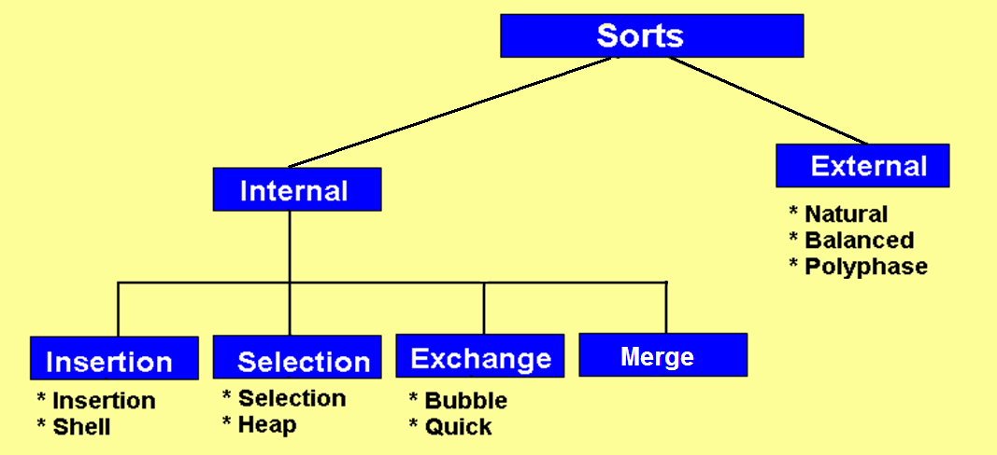
Sorting
16

Slide 17
Straight Insertion Sort
Algorithm StraightInsertionSort (list, last)
//sort the list in ascending order.
//list must contain at least one element
//last is index to last element in the list
set current to 1
loop (current <= last) //loop until last element is sorted
set temp to list [current]
set walker to current - 1
loop (temp < list[walker] AND walker>=0)
//move walker element right one element
set list[walker+1] to list[walker]
decrement walker
end loop
set list[walker + 1] to temp
increment current
end loop
End StraightInsertionSort

Slide 18
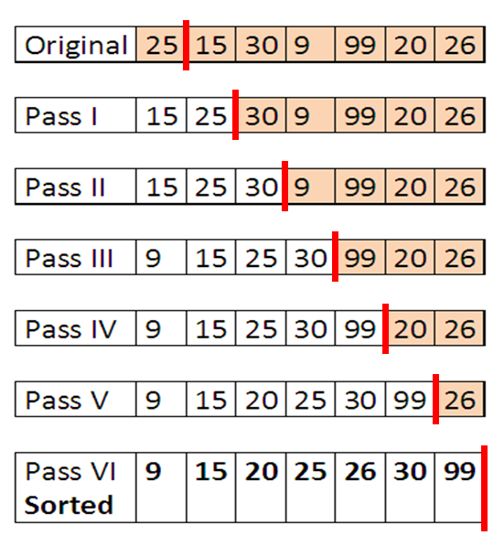
Straight Insertion Sort - Example
To sort an array with n elements Insertion sort requires n-1 passes

Slide 19
Straight Insertion Sort
Efficiency is O(n²)
The outer loop executes n-1 times.
For each outer loop the inner loop executes from 0 to
current times,
depending on the relationship between the temp key
and walker key.
On the average, we expect the inner loop to process
through the data
in half of the sorted list. Because the inner loop depends
on the setting
for current, which is controlled by the outer loop, we have
a dependent
quadratic loop, which is mathematically stated as
F(n) = n ((n+1)/2) ➔ O(n2)
Notes:
The outer loop executes n-1 times.
For each outer loop the inner loop executes from 0 to current times, depending on the relationship between the temp key and walker key.
On the average, we expect the inner loop to process through the data in half of the sorted list. Because the inner loop depends on the setting for current, which is controlled by the outer loop, we have a dependent quadratic loop, which is mathematically stated as
F(n) = n ((n+1)/2) ➔ O(n2)

Slide 20
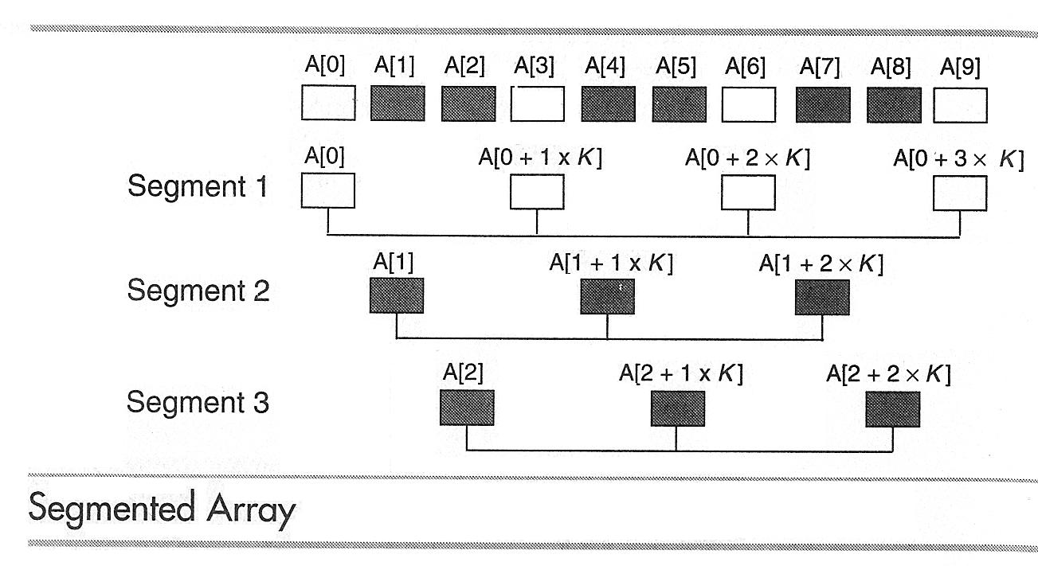
Shell Sort
N = 10, K = 3
If elements are out of sequence then exchange
After each pass increment is reduced until in the final pass it is 1
Compare A[0] and A[3] from first segment
Compare A[1] and A[4] from second segment
Compare A[2] and A[5] from third segment
Compare A[3] and A[6] from first segment …………
Finally compare A[6] and A[9].

Slide 21
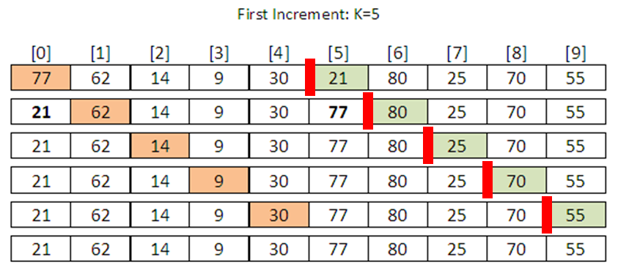
Shell Sort - Example

Slide 22
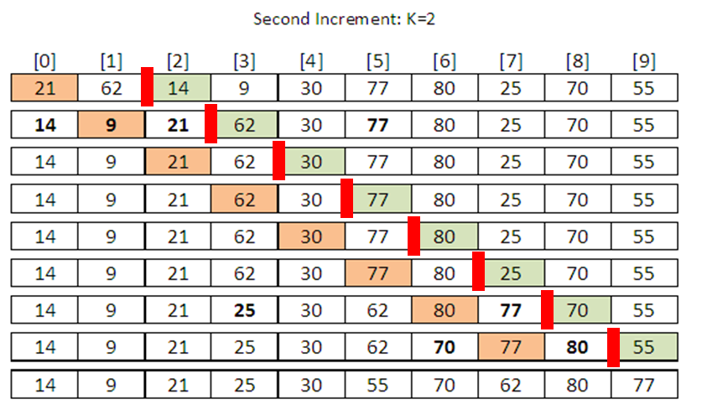
Shell Sort - Example
Seg# 1 2 1 2 1 2 1 2 1 2

Slide 23
Shell Sort - Algorithm
Algorithm ShellSort (list, last)
//sort (in-place) the list in ascending order.
//last is index to last element in the list, k is increment
set k to last/2
//compare keys “increment” elements apart
loop (k not 0)
set current to k
loop (until last element sorted)
set hold to list[current]
set walker to current-k
loop (walker>=0 AND hold < list[walker])
//move larger element up in list (segment)
move list[walker] one increment right
//fall back one partition
set walker to walker-k
end loop
//Insert hold in proper relative location
set list[walker+k] to hold
increment current
end loop
//End of pass – calculate next increment
set k to k/2
end loop
End ShellSort

Slide 24
Shell Sort
Decision to select optimal Increment size varies
Efficiency is O(n ^{1.25})
Notes:
No increment size is best for all situations.
Important consideration in sort: to complete sort with minimum number of passes. Here minimum number of increments and to minimize the number of elements that appear in more than one segments.
Solution 1: use prime numbers as increments. But dynamic calculation of prime numbers is relatively slow.
Solution 2: setting the increment to half the list size and dividing by 2 on each pass.
According to Knuth, we should not start with k > one third of the list size.
Solution 3: increments be the power of 2 minus 1 or a fibonacci series. ➔ slightly more efficient but complex.
Solution 4: division-by-2 approach with variation. Add 1 if increment is even ➔ reduce number of elements that appear in more than one segments.

Slide 25
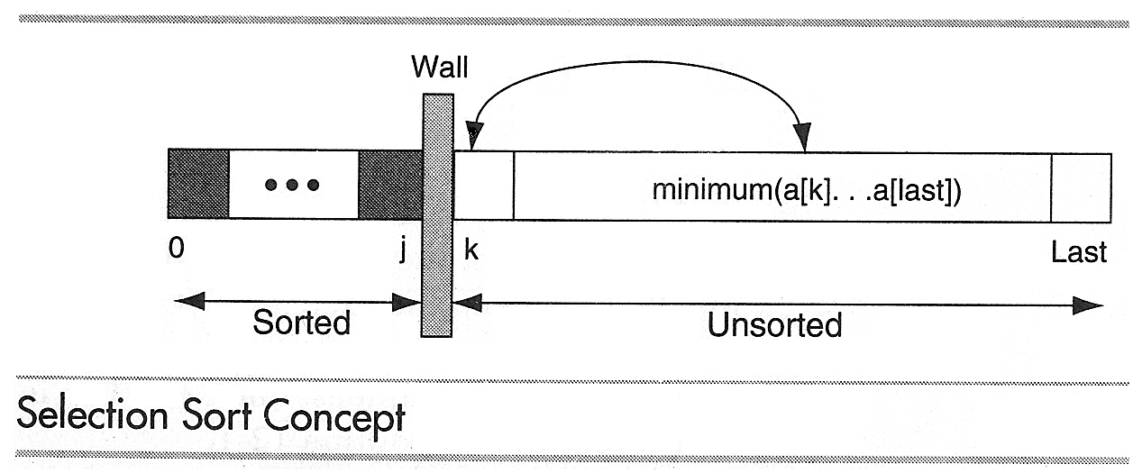
Selection Sort
In each pass of the selection sort, the smallest element is selected from the unsorted sublist and exchanged with the element at the beginning of the unsorted list

Slide 26
Straight Selection Sort
Algorithm StraightSelectionSort (list, last)
//sort the list in ascending order.
//list must contain at least one element
//last is index to last element in the list
set current to 0
loop (current <= last) //loop until last element is sorted
set smallest to current
set walker to current + 1
loop (walker <= last)
if (walker key < smallest key)
set smallest to walker
end if
increment walker
end loop
//smallest selected : exchange with current element
exchange (current, smallest)
increment current
end loop
End StraightSelectionSort

Slide 27
Heap Sort
Steps in Algorithm
Turn the array to be sorted into a heap
Repeat step 3 and 4 until the entire list is sorted
Exchange the root (the largest element in the heap) with the last element in the unsorted list ➔ results in the largest elements being added to the beginning of sorted list
Reheap the unsorted list

Slide 28
Heap Sort
Efficiency of heap sort is O(n log n)
Efficiency of straight selection sort is O(n²)

Slide 29
Exchange Sorts
Exchange elements that are out of order until the entire list is sorted
Virtually every sorting method uses some form of exchange, the sorts under this category use it extensively

Slide 30
Exchange Sorts
Bubble Sort
The most common sort
Quick Sort
The most efficient general purpose sort

Slide 31
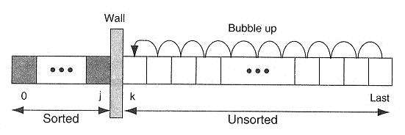
Bubble Sort Concept

Slide 32
Algorithm BubbleSort (list, last)
//sort the list in ascending order.
//list must contain at least one element
//last is index to last element in the list
set current to 0
set sorted to false
loop (current <= last AND sorted false)
//Each iteration is one sort pass
set sorted to true
set walker to last
loop (walker > current)
if (walker key < walker - 1 key)
set sorted to false
swap (walker, walker-1)
end if
decrement walker
end loop
increment current
end loop
End bubbleSort

Slide 33
Quick Sort
33
Most popular sorting technique
Developed by C.A.R. Hoare
In-place, Divide and conquer, Massively recursive sort
Simple in theory but difficult to put into the code

Slide 34
Quick Sort
Divide-and-conquer algorithm
Divide: partition array into 2 subarrays such that elements in the lower part <= elements in the higher part
Conquer: recursively sort the 2 subarrays
Combine: sorting is done in-place

Slide 35
Quick Sort
35
The recursive algorithm consists of four steps:
If there are one or less element in the array to be sorted, return immediately
Pick an element in the array to serve as a “pivot” point. (Usually the left-most element in the array is used.)
Split the array into three parts –
A partition of elements less than the pivot
The pivot element
A partition of elements greater than or equal to the pivot
Recursively quick sort the left partition followed by quick sort the right partition

Slide 36
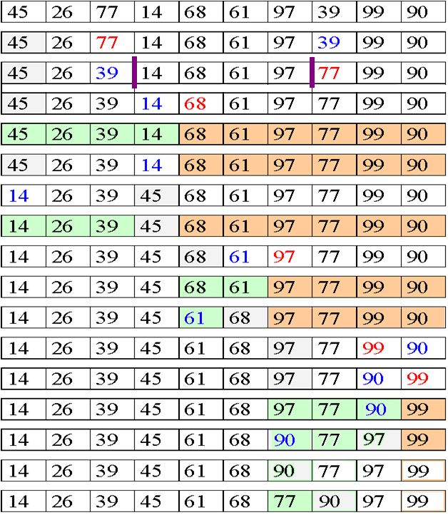
Pivot = 45
Cross Over low>high
Fix position of pivot
Three parts
1st element is pivot, now start two traversal, from left, find the first element > pivot
And from right find 1st element < pivot, then exchange them, continue till left<=right
Then exchange pivot with current left index value. This pass you will get all elements
On left of pivot less then pivot and on tight > pivot. Continue this process till

Slide 37
Quick Sort - Algorithm
Algorithm QuickSort(a,l,h)
//a is list of elements
//l is the position of the first element in the list
//h is the position of the last element in the list
Step 1: low = l+1, high = h, pivot = a[l]
Step 2: Loop (low < high)
// beginning from left find first element greater than pivot
Loop (a[low] <= pivot and low<=h )
increment low
End loop
// beginning from right find first element smaller than pivot
Loop (a[high] > pivot)
decrement high
End loop
// check the cross over
if (low < high)
swap(a[low],a[high])
increment low
decrement high
end if
End Loop
a[l]=a[high]
a[high]=pivot // Fix the position of pivot
Step 3: if (l<high) QuickSort(a,l,high-1)
Step 4: if (low<h) QuickSort(a,high+1,h)
Step 5: Return
End QuickSort
37

Slide 38
Complexity of Quick Sort
Most efficient when the pivot key is in the middle of the array (we can use median value as pivot key)
Complexity of Quick Sort is
O(n log n)
38

Slide 39
Merge Sort
Given an array
Form the sorted subarrays
Go on merging the pairs of sorted subarrays

Slide 40
Merge Sort - Example
Array size, n = 14
66, 33, 40, 22, 55, 88, 60, 11, 80, 20, 50, 44, 77, 30
Pass 1: Merge each pair of elements ➔ list of sorted pairs
33, 66, 22, 40, 55, 88, 11, 60, 20, 80, 44, 50, 30, 70
Pass 2: Merge each pair of pairs ➔ list of sorted quadruplets
22, 33, 40, 66, 11, 55, 60, 88, 20, 44, 50, 80, 30, 70
Pass 3: Merge each pair of sorted quadruplets ➔ sorted subarrays
11, 22, 33, 40, 55, 60, 66, 88, 20, 30, 44, 50, 70, 80
Pass 3: Merge two sorted subarrays ➔ single sorted array
11, 20, 22, 30, 33, 40, 44, 50, 55, 60, 66, 70, 80, 88

Slide 41
Merge Sort
Algorithm requires at most log n passes to sort an array of size n
Complexity is O(n log n)

Slide 42
Radix Sort
The method that we intuitively use to arrange list of names alphabetically
Here radix is 26 as there are 26 alphabets
➔ 26 pockets
Put names in appropriate pocket considering first alphabet in the name ➔ first pass
Put names in appropriate pocket considering second alphabet in the name ➔ second pass
Same process continues till the last alphabet in the longest name gets processed ………..

Slide 43
Radix Sort
If the list to be sorted includes numbers, then radix is 10 as there are 0,1, 2 …. 9 digits
➔ 10 pockets
Put numbers in appropriate pocket considering least significant bit ➔ first pass
Put numbers in appropriate pocket considering second significant bit ➔ second pass
Same process continues till the most significant bit of the largest number is processed ………..

Slide 44
Radix Sort - Example
The list to be sorted is
121, 70, 965, 432, 12, 577, 683
List after Pass-1 : 70, 121, 432, 12, 683, 965, 577
Pass-1
Input | 0 | 1 | 2 | 3 | 4 | 5 | 6 | 7 | 8 | 9
121 |  | 121
70 | 70
965 |  |  |  |  |  | 965
432 |  |  | 432
12 |  |  | 12
577 |  |  |  |  |  |  |  | 577
683 |  |  |  | 683

Slide 45
Radix Sort - Example
Input for Pass-2
70, 121, 432, 12, 683, 965, 577
List after Pass-2 : 12, 121, 432, 965, 70, 577, 683
Pass-2
Input | 0 | 1 | 2 | 3 | 4 | 5 | 6 | 7 | 8 | 9
70 |  |  |  |  |  |  |  | 70
121 |  |  | 121
432 |  |  |  | 432
12 |  | 12
683 |  |  |  |  |  |  |  |  | 683
965 |  |  |  |  |  |  | 965
577 |  |  |  |  |  |  |  | 577

Slide 46
Radix Sort - Algorithm
Algorithm RadixSort(list, last)
//list is a list of elements
//last is the position of the last element in the list
Step 1: Find the largest element of the array
Step 2: set len to length of largest element
set pass to 1
set radix to 10
declare 10 arrays of size last+1
pocket[][radix]
Step 3: Loop ( pass <= len)
set k to 0
Loop (k<=last)
set digit to (pass) significant bit
put list[k] in pocket[k][digit]
End loop
Loop (r<radix)
End Loop
Step 3: if (l<high) QuickSort(a,l,high)
Step 4: if (low<h) QuickSort(a,low,h)
Step 5: Return
End QuickSort

Slide 47
Comparison of Sorting algorithms
Sort | Average | Best | Worst | Space | Stability
Insertion Sort | O(n²) | O(n) | O(n²) | Constant | Stable
Shell Sort | O(n^{1.25}) | O(n^{1.25}) | O(n²) | Constant | Stable
Selection Sort | O(n²) | O(n²) | O(n²) | Constant | Stable
Heap Sort | O(n log n) | O(n log n) | O(n log n) | Constant | Unstable
Quick Sort | O(n log n) | O(n log n) | O(n²) | Constant | Stable
Merge Sort | O(n log n) | O(n log n) | O(n log n) | Not constant | Stable
Radix Sort | O(n log n) | O(n log n) | O(n²) | Not Constant | Stable

Slide 48
External Sorts
External sorts allow portions of the data to be stored in secondary memory during the sorting process
Steps
Sorting blocks of data internally and writing them into files
Once all the data have been sorted internally, merging of these sorted files

Slide 49
Hashed List Searches
Goal : To find the data with only one test
The key, through an algorithmic function, determines the location of the data
Hashing is a Key-to-address mapping process
Notes:
Earlier search techniques require several tests before we can find the data.

Slide 50
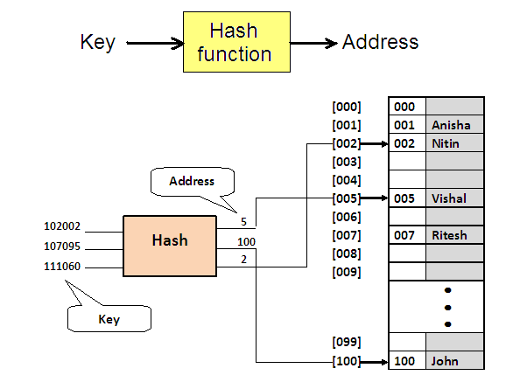
Hash Concept

Slide 51
Hash Concept
Set of keys that hash to the same location – Synonyms
If the actual data to be inserted contain two or more synonyms – collision occurs

Slide 52
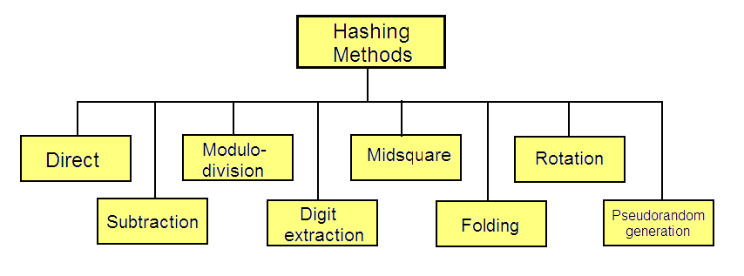
Hashing Methods

Slide 53
Direct Hashing
The key is the address without any algorithmic manipulation
Limited use
Very powerful because
No synonyms
No collisions

Slide 54
Subtraction Method
Used when keys are consecutive but do not start from 1
Hash function subtracts a number from the key to determine the address
Simple method : No collisions
Used only for small lists in which the keys map to a densely filled list

Slide 55
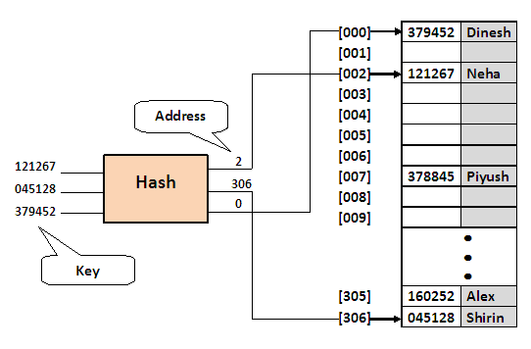
Modulo-division - Example
To provide data space for up to 300 employees. First prime number greater than 300 is 307➔ choose 307 as list size
Neha’s employee number = 121267
121267/307 = 395 with remainder of 2
➔ hash(121267) = 2

Slide 56
Digit-extraction Method
Selected digits are extracted from the key and used as the address
E.g. using six-digit number to hash to a three-digit address (000-999)
379452 394
121267 112
378845 388
160252 102
045128 051

Slide 57
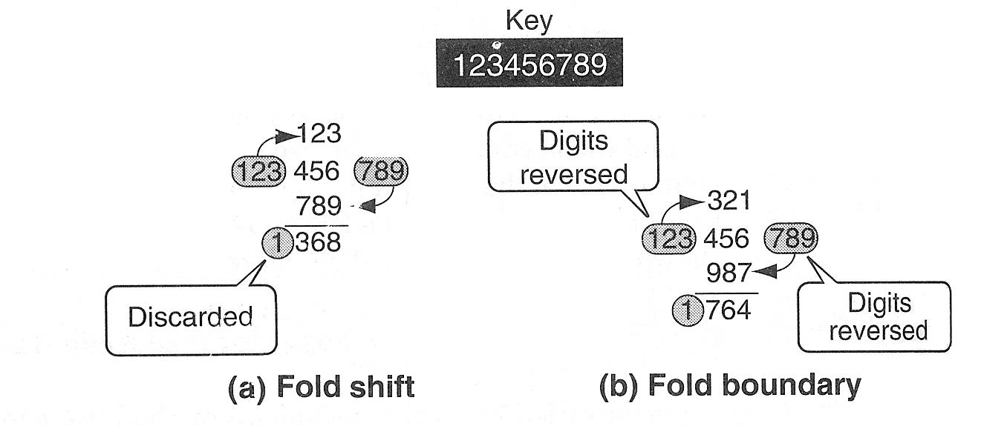
Folding Method - Example

Slide 58
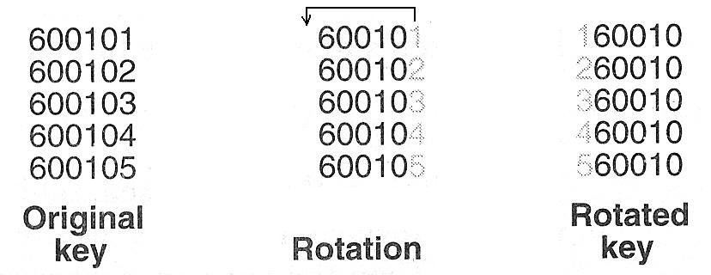
Rotation Method - Example

Slide 59
Pseudorandom Hashing
The key is used as the seed in a pseudorandom-number generator, and the resulting random number is then scaled into the possible address range using modulo-division
Given a fixed seed, pseudorandom-number generators always generate the same series of numbers

Slide 60
Pseudorandom Hashing
A common random-generator is
y = ax + c
Set x to the key
Compute y and divide it by list size ➔ remainder is hashed address
For maximum efficiency a and c should be prime numbers

Slide 61
Pseudorandom Hashing - Example
If key = 121267, a = 17 and c = 7 then
y = ((17 * 121267) + 7) modulo 307
y = 2061546 modulo 307
y = 41

Slide 62
All hash functions except direct hashing and subtraction hashing are many-to-one functions ➔ many keys hash to one address ➔ create collision ➔ Collision Resolution methods required

Slide 63
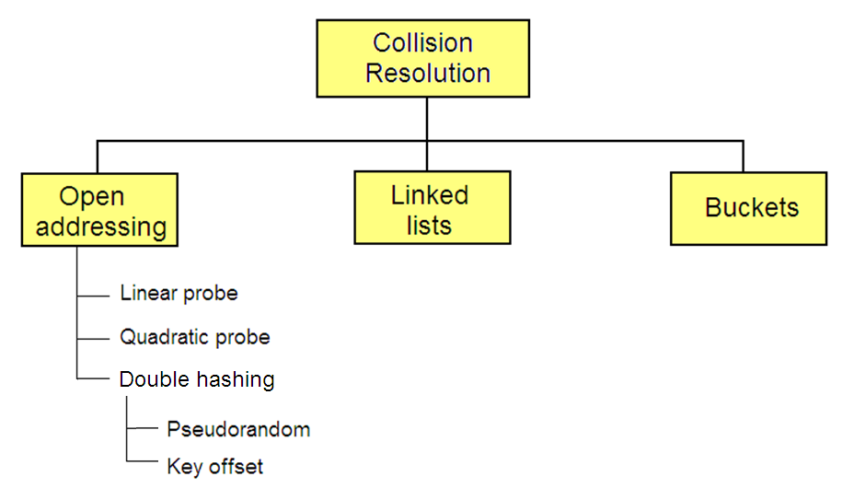
Collision Resolution Methods
Notes:
With the exception of the direct and subtraction methods, none of the methods used for hashing is one-to-one mapping. Thus when we hash a new key to an address, we may create a collision.
The methods for handling collisions are independent of the hashing algorithms. That is, each hashing method can be used with each of the collision resolution methods.

Slide 64
Collision Resolution
There must be some empty records / elements in a list at all times
As a rule, a hashed list should not be allowed to become more than 75% full
➔ load factor

Slide 65
Collision Resolution – Open Addressing
Linear Probing
Simplest method
Resolve the collision by adding 1 to the current address

Slide 66
Collision Resolution – Open Addressing
Double Hashing
Minimizes clustering in linear probing
A second hash function H’ is used for resolving a collision
Suppose a record R with key k has the hash addresses H(k) = h and H ’(k) = h ’ ≠ m. Then we linearly search the locations with addresses
h, h + h’, h + 2h’, h + 3h’, …
If the number m of the locations in the table T is a prime number, then the above sequence will access all the locations in T.

Slide 67
Collision Resolution – Linked Lists
Uses a separate area to store collisions and chains all synonyms together in a linked list
Uses two storage areas: the prime area and the overflow area
Each record in the prime area contains an additional field – a link to a linked list of overflow data in the overflow area

Slide 68
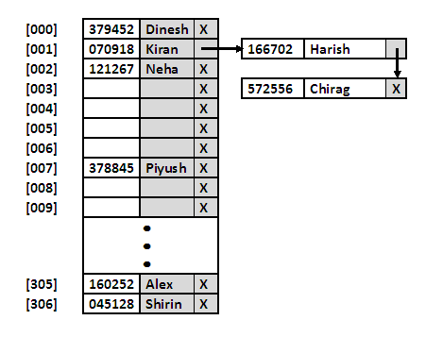
Collision Resolution – Linked Lists

